Slide 1
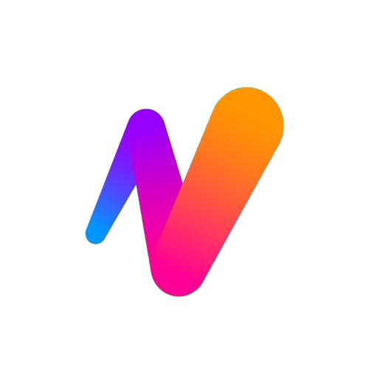
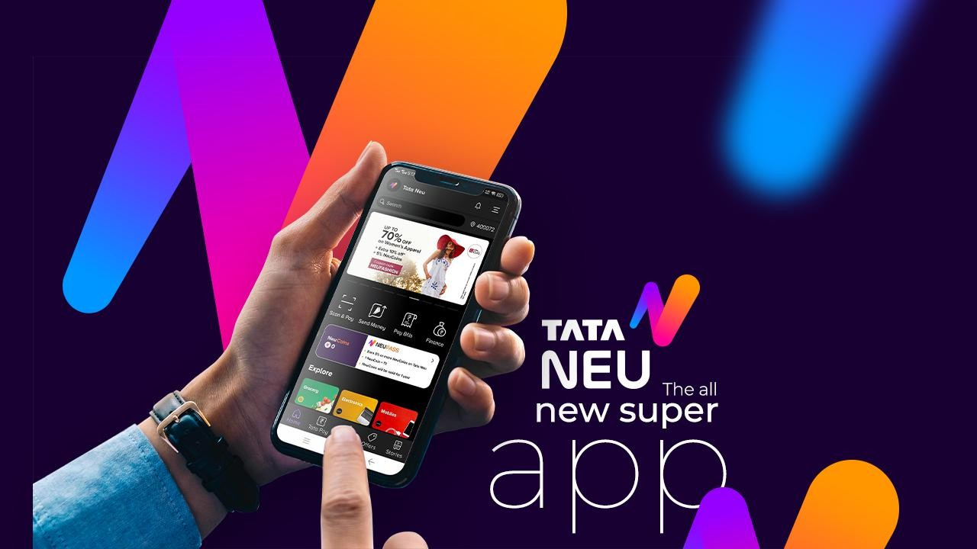
TATA
NEU
Improving App Adoption and Acquisition of Tata Neu
Case Study by: R. Hardhika
IIT Guwahati

Slide 2
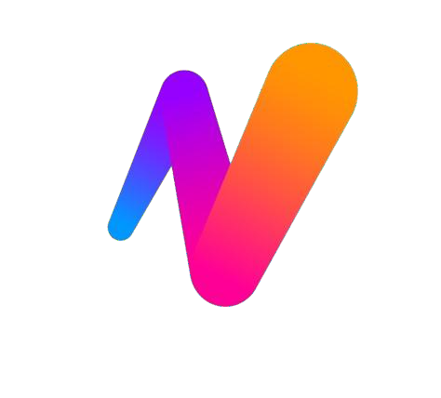



PROBLEM STATEMENT
|
| About Tata Neu
|
|
|
|
|
|
|
|
|
|
|
|
|
|
|
|
|
|
|
|
|
|
|
|
|
|
|
|
|
|
|
|
|
The Tata Group reportedly injected an additional $2 billion into its struggling super app, Tata Neu, in April 2023, in an attempt to bolster its digital business. You, as the Chief Product Officer, want to boost the product and digital strategy of the app, with the first phase focusing on acquiring new users and increasing adoption among current Tata offline users. You want to introduce new features on the app that make the first phase successful.
OBJECTIVES
Tata Neu is a multi-purpose super-app, developed in India by the Tata Group. It is the country's first super-app. The app was launched to coincide with the start of a 2022 Indian Premier League match.
What is a SuperApp ?
A super-app is a application that can provide multiple services including payment, effectively becoming an all- encompassing self-contained commerce and communication online platform.
Strategise and prioritise product features to be rolled out on current super app
Deduce the success metrics
Develop go-to- market plan/strategy to acquire new users

Slide 3






OVERVIEW
Was downloaded
over 11 million times during April & May, and 2.2 million times within a week of lauch.
Clocked around
$120-150 millionrevenue in its firts month, below the target to over $200 million.
Company expects
at least 50% of people who use a Tata app to move to Neu.
Rewards buyers with Neu coins which are reedemable for services
provided through the app.
Yet to onboard Vistara, Air India, Titan,
Tanishq, Tata Binge Play & Tata Motors.
Over 229 million people watched the IPL,
which Tata Neu sponsored.

Slide 4



USER PERSONAS
|
|
|
|
|
|
|
|
|
|
|
|
|
|
|
|
|
|
|
|
|
|
|
|
|
|
|
|
|
|
|
|
|
|
|
|
|
|
Swappan Duttaa 34 | Male | Kolkata
Frequent Big Basket user
“I would prefer to use individual apps over the Tata Neu super app. It looks like bunch of webpages are stiched together. Proper integration of BigBasket with Tata Neu is missing bigtime.”
|
|
|
|
|
|
|
|
|
|
|
|
|
|
|
|
|
|
|
|
|
|
Keerti Sharma 22 | Female | Pune
Loves Cashback & Rewards
“Searching is very bad, you won’t search items 9 out of 10 times. Search feature will never give you intended results and you will have navigate manually via categories. There is also no common customer service support.”
Shriram Rajasekaran 26 | Male | Kozhikode
Always prefer Online Shoping
“There is no easy way to track one’s order or look what you have ordered in the past. There is no icon for track your order. There is no unified cart or orders page. The super app feels like an app in an app experience”
PAIN POINTS
Not user friendly
Laggy and slow
No edit opption in address
PAIN POINTS
Bad search results
PAIN POINTS
No icon to track your order
No common cart
No unified orders page
Long loading times
|
Poor & non centralised customer service |

Slide 5
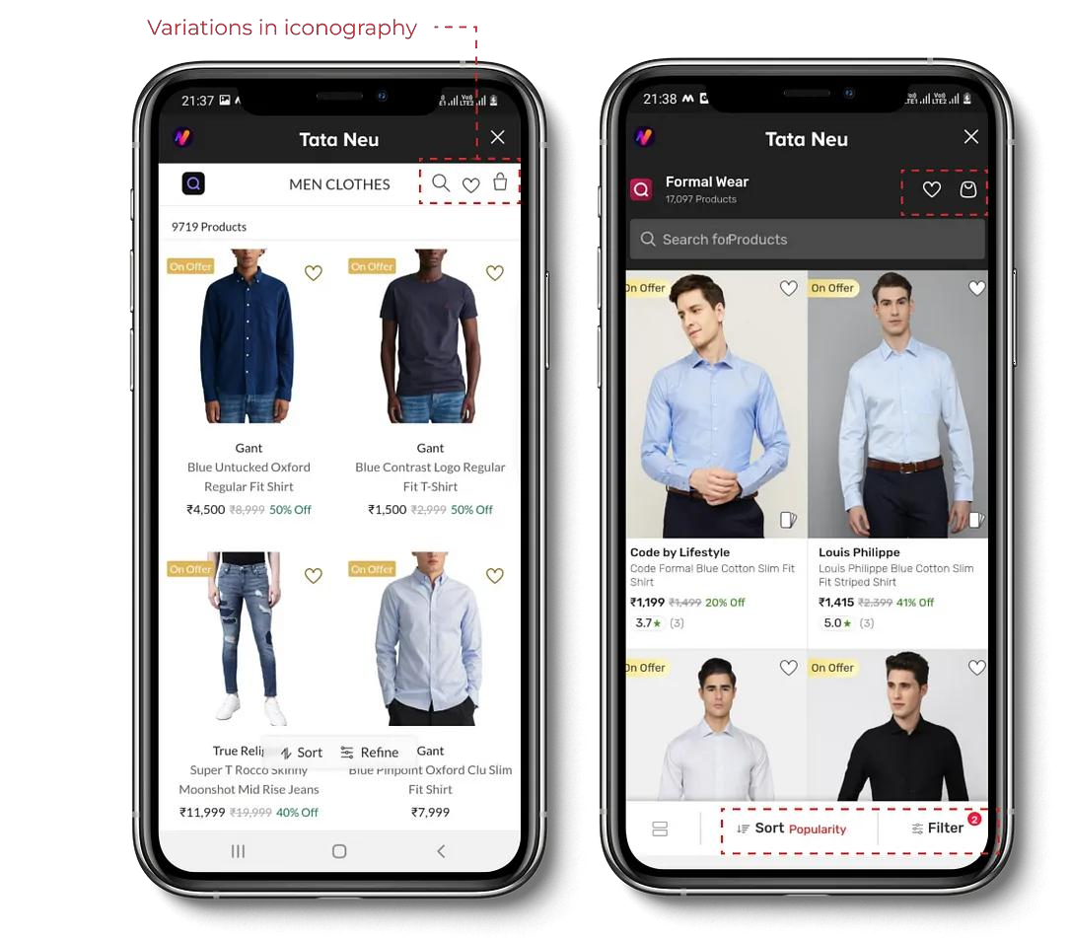
RECOMMENDATION #1 : A Native App with Uniform UI
What are the issues ?
The App looks like a bunch of webpages stiched together.
The app feels like an app inside an app rather than a super-app that provides multiple services.
What can be done ?
Native App Development: Transition from the current webview/app-in- app structure to a fully native app environment. This shift ensures a smoother and more responsive user interface.
Consistent Iconography: Implement a standardized set of icons belonging to the same family across all services and brands within the super app.
Common UI Design: Enforce a common user interface (UI) design across all services and brands integrated into the super app. This includes standardized navigation patterns, color schemes, and layout structures.
What can be achieved ?
Enhanced user experience
Improved user retention
Efficient task completion
Increased user engagement and conversion rate
|
|
|
|
|
|
Variations in UI

Slide 6
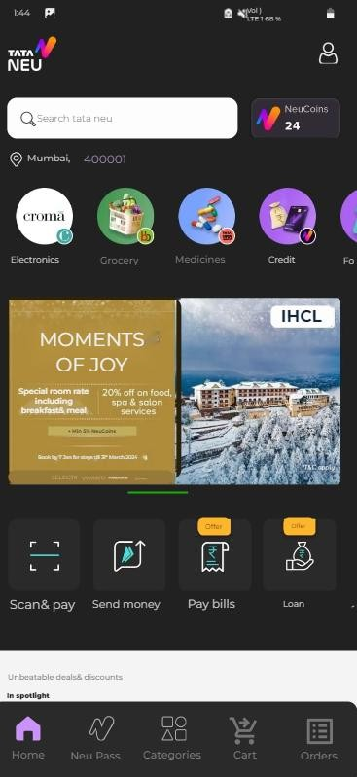
RECOMMENDATION #2: Common Cart & Unified Orders Page
What are the issues ?
Lack of common shopping cart.
Absence of unified orders page.
What can be done ?
Common Cart: Introduce a centralized shopping cart that allows users to add items from various categories and brands within the super app.
This would enable users to conveniently purchase items from different brands and categories in a single transaction, streamlining the checkout process, reducing friction and enhancing user convenience.
Unified Orders Page: Create a dedicated section within the main super app that consolidates all user orders from different categories and brands of TATA . This would provides users with a centralized location to track and manage all their orders. enabling efficient order management, including tracking, returns, and order history review.
Clicking on this will take the users to the unified orders page, that sould contain orders from all the
brands/stores of TATA,
making it easier for users in tracking and returning of orders
What can be achieved ?
Streamlined order tracking & return process
Increased cross-selling opportunities
Seamless shopping experience
Improved user satisfaction
Users can click here to go to the centralized shopping cart that would contain items from different categories and sub-brands of TATA.

Slide 7
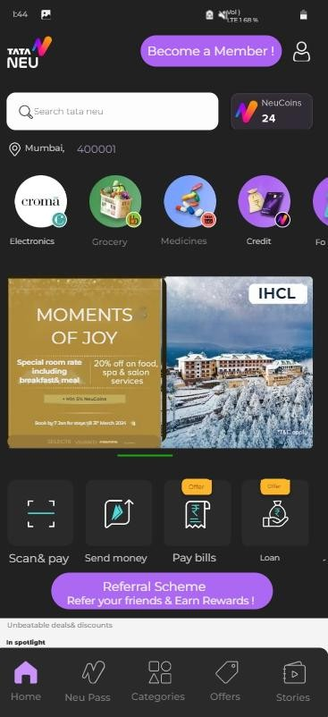
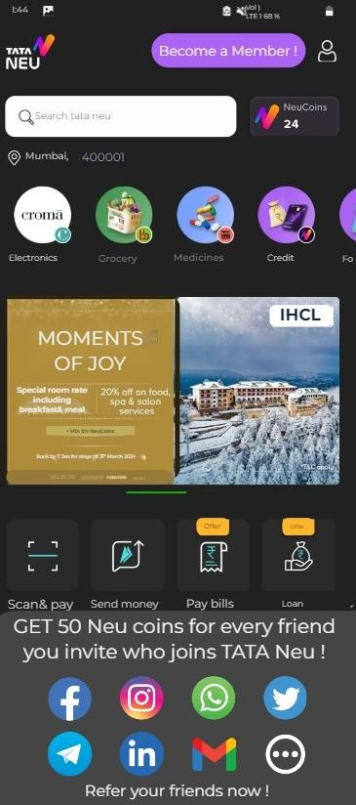
RECOMMENDATION #3: Referral Scheme
What are the issues ?
Despite being under the TATA umbrella with various brands like bigbasket, 1mg, cliq, chroma, etc., the anticipated migration of 50% of users from these individual brand apps to TATA Neu did not materialize. The core issue lies in user onboarding and retention.
What can be done ?
Referral Program Implementation: Introduce a robust referral program within the TATA Neu app. This would motivate users to refer their connections, driving new user acquisition.
Neu Points as Incentives: The promise of Neu points acts as a tangible reward, encouraging both referrers and new users to actively engage with the app. Users can earn Neu points for every successful referral which can be redeemed for discounts, offers, or other tangible benefits within the app. Neu points act as a reward, incentivizing users to stay and actively purchase from TATA brands through the app.
What can be achieved ?
Increased user acquisition
Improved user retention
Positive Word-of-Mouth marketing
Increased monetization oportunities
Users can click on this to know about the perks of a successful referal and the select the medium to share the referral link.
This is the main referral scheme segment from which user can select the medium and share the referral link.

Slide 8
RECOMMENDATION #4: All in One Membership Program
Feature Overview :
Early Access to Sales and Product Launches:
Description:
Users can subscribe to a single All-in-One Membership, gaining access to exclusive benefits across various TATA brands and apps within the super app without subscribing for individual app pro- membership.
Membership Benefits:
Free & Priority Delivery:
Enjoy complimentary and expedited delivery services across all brands and services within the super app, eliminating additional charges.
2x Neu Points Accumulation:
Earn Neu points at an accelerated rate for every purchase made through the super app, doubling the rewards for loyal All-in-One members.
Exclusive Discounts and Promotions:
Access members-only discounts and promotions, ensuring All-in- One members receive the best deals and savings across brands.
Enjoy exclusive early access to sales events and new product launches, providing a competitive advantage for All-in-One members.
Complimentary Services and Add-ons:
Access complimentary services or add-ons, such as extended retur period, free trials, or bonus features like free gift wrap option in certain product category.
3. Membership Tiers:
Introduce tiered membership levels with escalating benefits based on the duration or level of engagement as an All-in-One member (e.g., Silver, Gold).

Slide 9
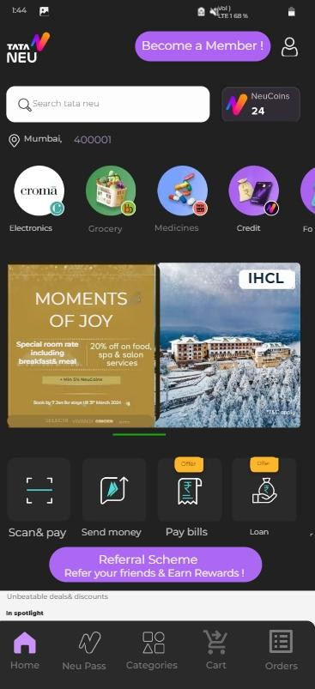
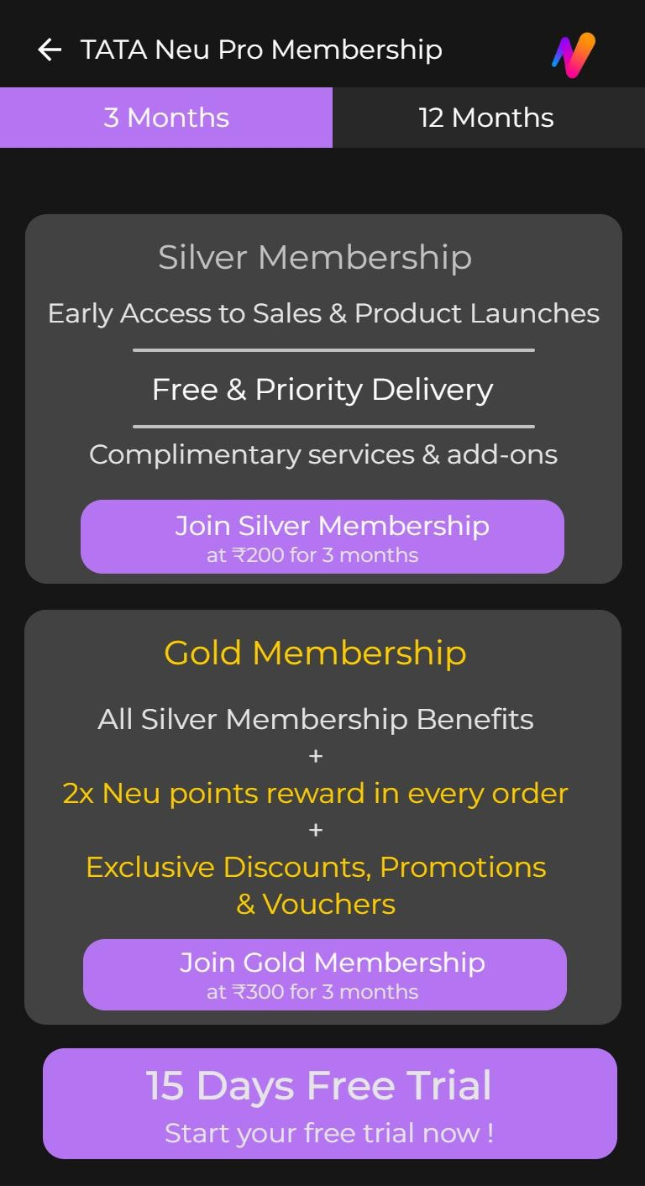
RECOMMENDATION #4: All in One Membership Program
Users can click on this to
This toggle allows user to chose the duration of
go to the pro membership screen.
-----------------------------
------------------------------ _{pro membership (3}
months or 12 monts).
This segment displays
------------------------------ _{the benefits of the Silver}
Membership
Users can click on this button
------------------------------ _{to proceed to payment for the}
Silver Membership
This segment displays
------------------------------ the benefits of the Gold
Membership
Users can click on this button
------------------------------ to proceed to payment for the
Gold Membership
Direct Call-To-Action (CTA) to
------------------------------ get onboarded for the 15 days
free trial

Slide 10
RECOMMENDATION #5 : One stop Travel/Itinerary Planner
Feature Overview:
Restaurant Booking (Qmin):
User Input:
Destination
Duration of Stay
AI Itinerary Generation:
Utilize Chat GPT API to analyze user inputs and generate a personalized itinerary.
Include suggestions for activities, attractions, and experiences based on user preferences and the destination.
Optimize the itinerary for the specified duration, ensuring a well-balanced and enjoyable travel plan.
Seamless Integration with TATA Brands:
Hotel Booking (IHCL):
Integrate IHCL's hotel booking system to suggest and enable seamless hotel reservations.
Provide details about available TATA hotels, amenities, and pricing.
Include booking options directly within the app, ensuring a streamlined user experience.
Integrate Qmin's restaurant booking system to suggest and enable restaurant reservations.
Showcase a variety of dining options based on user preferences and location.
Enable users to make restaurant reservations directly
through the app.
Flight Booking (Air India & Vistara):
Integrate Air India Express, Air India and Vistara's flight booking systems to suggest and enable flight reservations.
Provide information on available flights, schedules, and pricing.
Facilitate secure flight bookings within the app, creating a unified travel planning solution.
Booking and Payment Integration:
Implement a secure payment gateway to facilitate seamless and secure transactions enabling users to make bookings and payments for hotels, restaurants, and flights within the app.
What can be achieved ?
Cross-selling across multiple & diverse TATA brands.

Slide 11
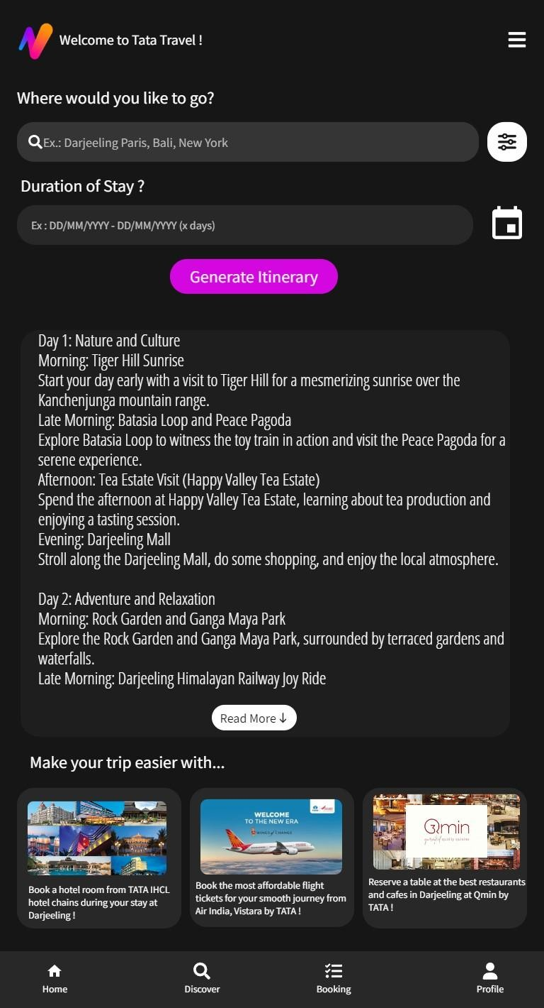
RECOMMENDATION #5 : One stop Travel/Itinerary Planner
This is where users can input their desired destination. Users can type the name of a city or landmark, and the app will provide suggestions as they type.
--------------------------
Users can select the duration of their stay by interacting with the calendar option. This allows them to pick the check-in and check- out dates for their trip.
--------------------------
Users can trigger the AI to
generate an itinerary by clicking -------------------------------------------
this button.
This is where the AI-generated itinerary by ChatGPT (using ChatGPT API) is displayed. After users have selected their preferences, the app compiles a personalized itinerary for their trip.
--------------------------
The app provides flight (Air India, Air India Express & Vistara) suggestions based on the selected destination and travel dates. Users can view details like flight times, prices, and airlines.
Once a destination is selected, the app suggests hotels (IHCL) based on user preferences. Users can view recommendations with details like ratings, prices, and amenities.
-------------------------------------------------
Users can explore restaurant (Qmin) options in the selected destination.
Recommendations include details such as cuisine, reviews, and proximity to the user's location.
--------------------------
--------------------------
Discover pre-generated itineraries of top and famous destinations
-------------------------------------------
Proceed with the itinerary & booking ,
------------------------------------------- _{and make payments.}

Slide 12
FEATURE PRORITISATION
RICE FRAMEWORK
FEATURE | REACH | IMPACT | CONFIDENCE | EFFORT | SCORE
Native App with Uniform UI | 4 | 5 | 100% | 5 | 4
Common Cart & Unified Orders Page | 3.5 | 4.5 | 90% | 4 | 3.54
Referral Scheme | 4 | 3 | 65% | 2.5 | 3.12
Membership Program | 3 | 3.5 | 70% | 2.5 | 2.94
Travel/Itinerary Planner | 3 | 3 | 60% | 3 | 1.8
Scoring :
Reach (R), Impact (I), Effort (E) : 1-5
5 = High
3 = Moderate
1 = Low
Confidence: 0-100%
100% = High Confidence 75% = Moderate Confidence 50% = Low Confidence
<50% = Avoid Implementing Feature
Final Score:
Reach x Impact x Confidence
Effort

Slide 13
FEATURE PRIORITISATION
Big Bets
Quick Wins
Native App with Uniform UI
Common cart & Unified Orders Page
IMPACT
Membership Program
Travel/Itinerary Planner
Referral
IMPACT-EFFORT MATRIX
Money Pits
Scheme
Fill-ins
EFFORT
Based on our RICE scores the Priority order of Implementing Features are:
Common cart
Native app with Uniform UI
Referral Scheme
Membership Program
Travel/Itinerary Planner
& Unified Orders Page

Slide 14
SUCCESS METRICS
|
FEATURE
|
|
|
KEY PERFORMANCE INDICATORS (KPIs)
|
|
|
|
|
|
User Adoption (increase in number of downloads/installations)
User Enagagement (average time spent, number of sessions per user, retention rate of users)
Technical Performance (app performance metrics like load times, responsiveness, stability & crashes)
Native App with Uniform UI
|
|
Operational Efficiency (efficiency of the common cart and unified orders page based on the time users take to complete transactions and the reduction in abandoned carts)
Revenue Growth (impact on revenue through increased order values and a streamlined checkout
Common Cart &
Unified Orders Page |
p₋r₋o₋c₋e₋ss₋)
|
|
|
| • Referral Conversion Rate (percentage of referred users who successfully convert into active users or
| make purchases)
| • User Acquisition (increase in the number of new users attributed to the referral program)
|
Referral Scheme
|
|
|
|
|
|
|
Membership Sign-ups (number of users subscribing to the membership program)
Revenue Growth (mpact on revenue through membership fees and increased user spending)
Membership Program
Retention and Loyalty (impact on user retention and loyalty through exclusive benefits and
in₋c₋e₋n₋ti₋v₋es fo₋r₋me₋m₋b₋e₋r₋s₋)
| • User Engagement (usage of the itinerary/travel planner, including the number of users utilizing the
| feature and the frequency of use)
| • Cross-Selling Conversion Rates (how well the cross-selling suggestions from multiple TATA brands
|
| within the itinerary planner convert into actual purchases)
Travel/Itinerary Planner

Slide 15
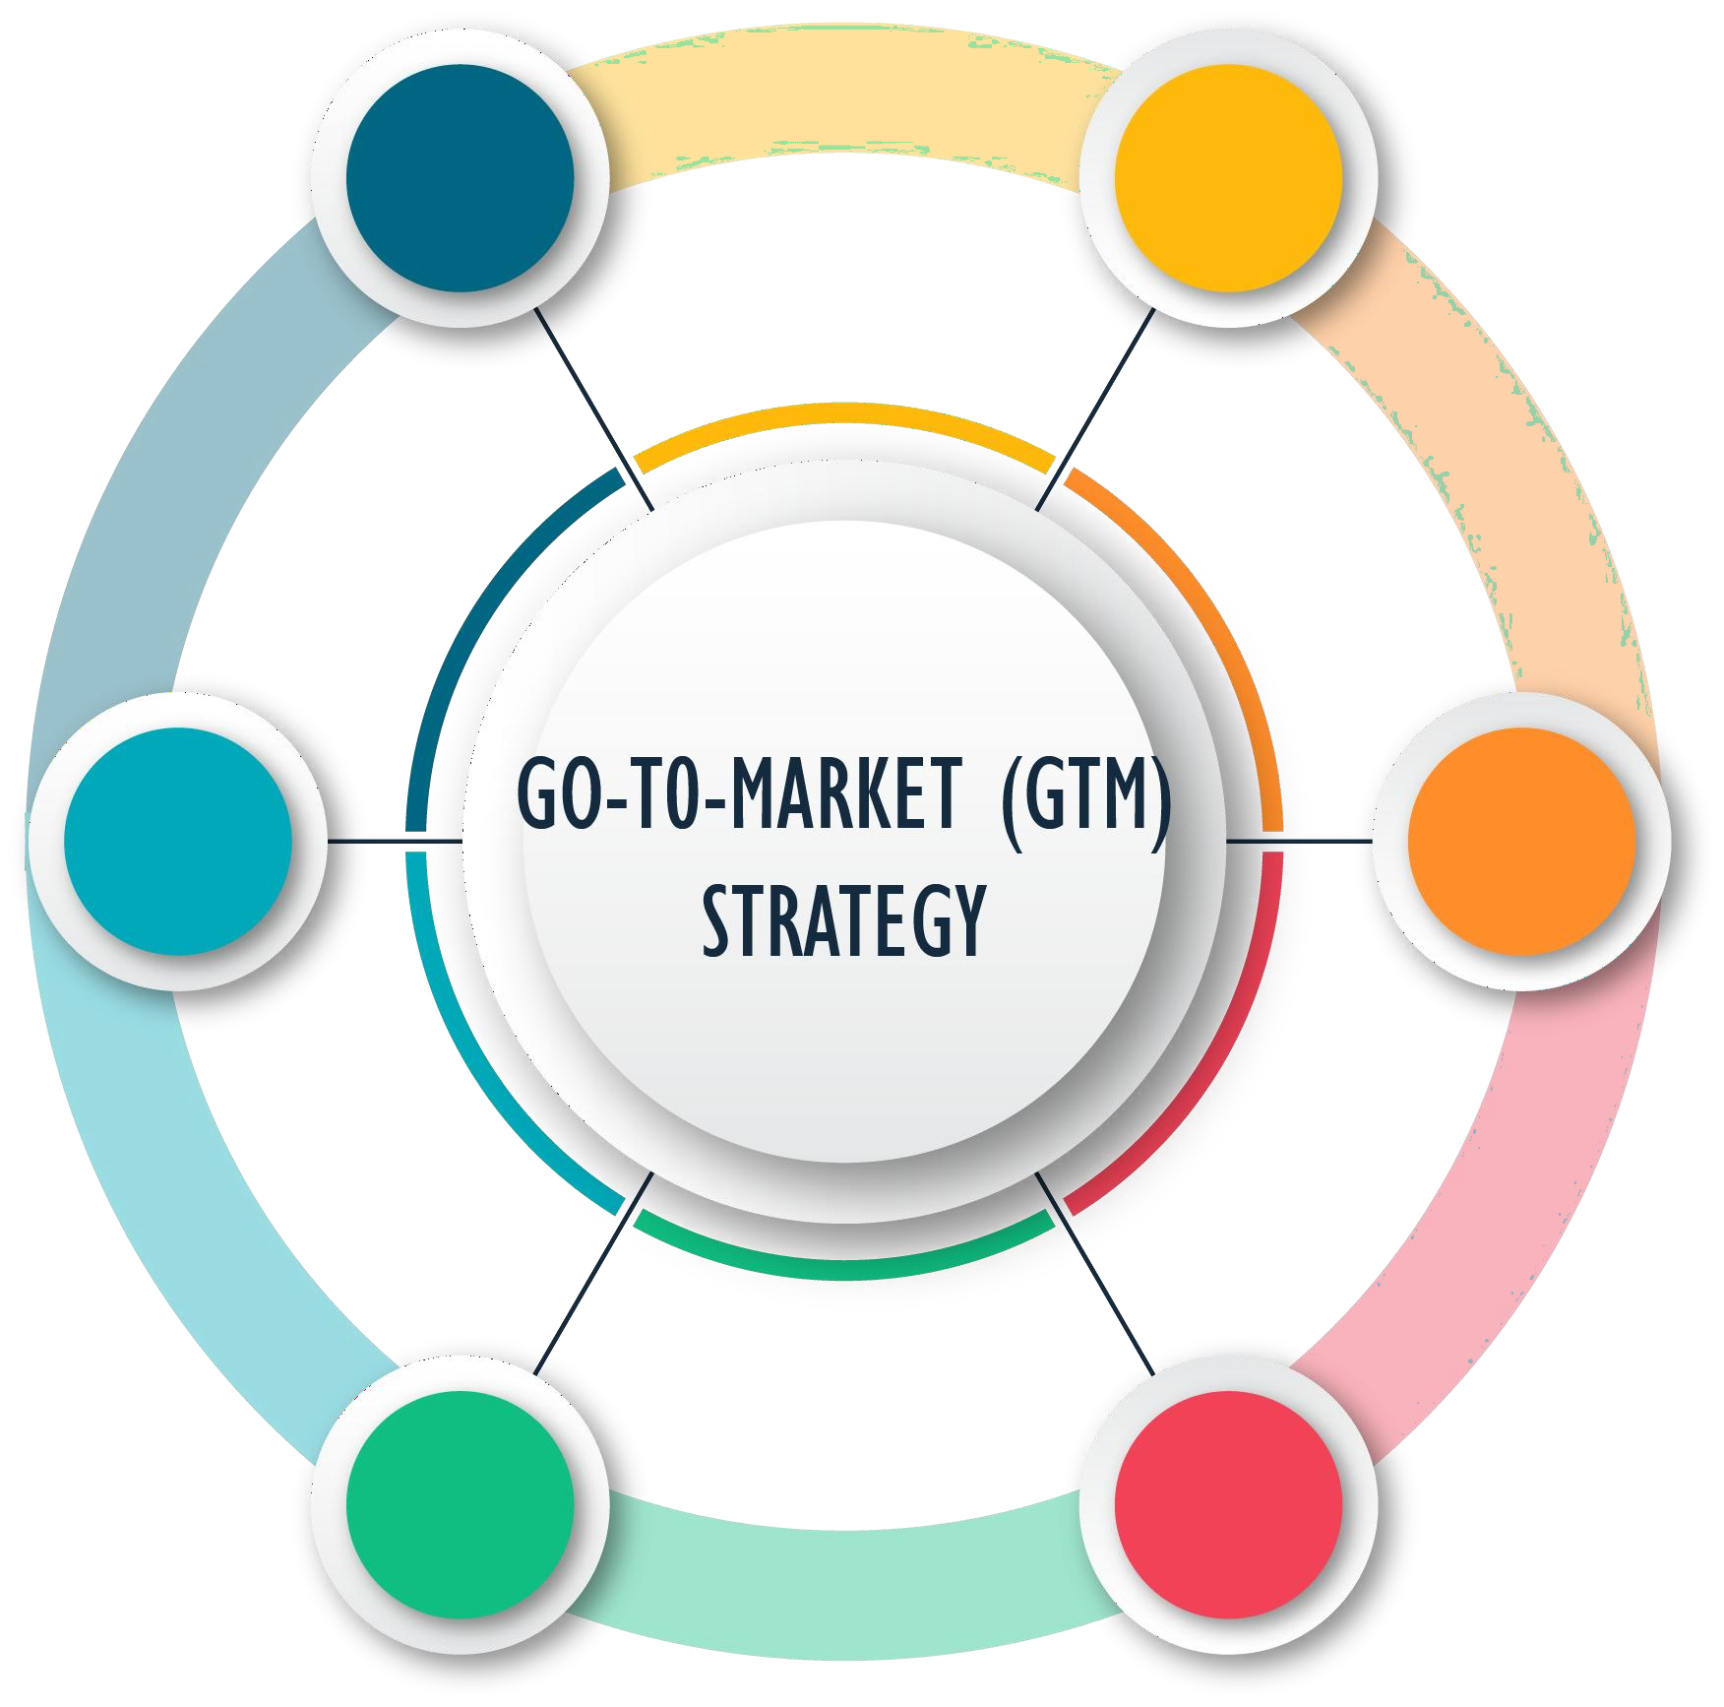
GO-TO-MARKET (GTM) STRATEGY
CUSTOMER FEEDBACK LOOP & RETENTION STRATEGIES
6
1
TARGET GROUP IDENTIFICATION
5
2
LAUNCH OF REVAMP
CAMPAiGn ThROuGh REFERRAL SChEME
DATA DRiVEn
MOnETizATiOn & DECiSiOn MAKinG
4
3
LAUNCH OF MARKETinG CAMPAiGn
inCEnTiVizED PRO-MEMBERShiP
LAunCh

Slide 16


















GO-TO-MARKET (GTM) STRATEGY
1. TARGET GROUP IDENTIFICATION
Luxury Concious TG
Value Concious TG
Price Concious TG
Travel
Hospitality
Fashion
F&B
E-Commerce
Retail
*TG = Target Group

Slide 17
GO-TO-MARKET (GTM) STRATEGY
LAUNCH OF REVAMP CAMPAIGN THROUGH REFERRAL SCHEME
Objective:
Generate buzz and excitement around the revamped super app by leveraging user networks through a referral program.
Actions:
Utilize the referral scheme to encourage existing users to refer friends and family to the app.
Offer incentives for both referrers and new users to drive participation.
Leverage social media, email, and other channels to promote the referral program and highlight the key improvements in the app.
INCENTIVIZED PRO-MEMBERSHIP LAUNCH
Objective:
Encourage early adoption of the Pro Membership program by offering exclusive benefits and a limited-time discount.
Actions:
Launch the Pro Membership with a special early bird offer, providing a discounted subscription rate for the initial period.
Clearly communicate the enhanced features and advantages of the Pro Membership.
Highlight the urgency of the limited-time offer to drive immediate sign-ups.

Slide 18
GO-TO-MARKET (GTM) STRATEGY
LAUNCH OF MARKETING CAMPAIGN
Objective:
Create a comprehensive marketing campaign to introduce the revamped super app to the target audience.
Actions:
Develop engaging and visually appealing marketing materials (videos, graphics, etc.) to showcase the app's new features.
Deploy a multi-channel marketing approach, including social media, email, press releases, and possibly traditional advertising.
Emphasize the key value propositions and benefits of the revamped app to attract new users.
DATA DRIVEN MONETIZATION & DECISION MAKING
Objective:
Utilize data to inform monetization strategies and make informed decisions based on user behavior and preferences.
Actions:
Implement tools and analytics to track user interactions, preferences, and purchasing behavior within the app.
Analyze data to identify trends, popular features, and areas for improvement.
Adjust monetization strategies based on data-driven insights to maximize revenue and user satisfaction.

Slide 19
GO-TO-MARKET (GTM) STRATEGY
CUSTOMER FEEDBACK LOOP & RETENTiON STRATEGY
Objective:
Establish a continuous feedback loop and implement strategies to retain users post-launch.
Actions:
Encourage users to provide feedback on the revamped app through surveys, in-app prompts, App Store/ Play Store reviews, and other channels.
Use feedback to make iterative improvements and address any issues or concerns.
Implement a retention strategy, including loyalty programs, exclusive offers, and ongoing communication to keep users engaged and satisfied.
OVERALL APP SUCCESS METRICS
Customer Satisfaction Scores (CSAT): User feedback specifically related to the implemented features to assess overall satisfaction.
Conversion Rates from Marketing Campaigns: How effectively marketing campaigns promoting the new features contribute to user engagement and conversions.
Technical Performance Metrics: Monitoring technical aspects to ensure the ongoing stability and performance of the app.
Data-Driven Monetization & Decision Making: Success of data-driven monetization strategies by tracking revenue growth and adjusting strategies based on user behavior and preferences.
Overall User Adoption and Engagement: Cumulative impact on overall user adoption, engagement, and satisfaction resulting from the combination of implemented features

Slide 20
THANK YOU

